Slide 1






TYPING SPEED AND
ACCURACY CALCULATOR
PROJECT
By Stuti Sinha

Slide 2
TABLE OF CONTENTS
ABSTRACt
CHAPTER – 1: INTRODUCTION
CHAPTER – 2: PROBLEM STATEMENT
CHAPTER – 3: PROPOSED SOLUTION
CHAPTER – 4: EXPERIMENTAL SETUP(INCLUDING CODE) AND RESULT ANALYSIS
CHAPTER – 5: CONCLUSION & FUTURE SCOPE
BIBLIOGRAPHY

Slide 3

ABSTRACT
THE TYPING SPEED CALCULATOR IS A DIGITAL TOOL DESIGNED TO ASSESS AND ENHANCE AN INDIVIDUAL'S TYPING PROFICIENCY. THIS ABSTRACT PROVIDES AN OVERVIEW OF ITS PURPOSE, FUNCTIONALITY, AND POTENTIAL BENEFITS. THE TYPING SPEED CALCULATOR AIMS TO EVALUATE AND IMPROVE TYPING SPEED AND ACCURACY FOR USERS OF ALL SKILL LEVELS. IT SERVES AS A VALUABLE TOOL FOR INDIVIDUALS LOOKING TO ENHANCE THEIR PRODUCTIVITY, AS WELL AS EDUCATORS AND EMPLOYERS SEEKING TO ASSESS AND DEVELOP THE TYPING SKILLS OF THEIR STUDENTS OR EMPLOYEES.

Slide 4
INTRODUCTION
In the modern digital age, the ability to type quickly and accurately is a fundamental skill that can greatly enhance productivity and efficiency in various aspects of our lives. Whether you're a student striving to excel in academic assignments, a professional aiming to meet tight deadlines, or an employer seeking to evaluate the typing proficiency of potential hires, the importance of typing speed and accuracy cannot be overstated. It is in this context that we introduce the Typing Speed Calculator project.
The Typing Speed Calculator is an innovative digital tool designed to assess, improve, and monitor your typing skills. This project aims to provide a comprehensive solution for individuals looking to enhance their typing capabilities, educators seeking to evaluate and support their students, and employers interested in recruiting skilled typists.

Slide 5






PROBLEM STATEMENT:
1. LACK OF RELIABLE TYPING SPEED ASSESSMENT TOOLS:
The current typing evaluation tools are limited, lacking accessibility, reliability, user-friendliness, customization, and advanced features. This hampers accurate assessment and improvement of keyboarding proficiency.
2. INADEQUATE EDUCATIONAL TYPING RESOURCES:
Educators struggle to find engaging and effective typing tools, impacting students' typing skill development. Our project addresses this gap by offering a resource that combines engagement, effectiveness, and features like customization and progress tracking for educators.
3. LIMITED EMPLOYMENT READINESS ASSESSMENT TOOLS:
Employers struggle with assessing typing skills during hiring due to a lack of user-friendly tools. Our Typing Speed Calculator simplifies this process, offering a reliable platform to enhance the efficiency of employment readiness assessments.
4. ACCESSIBILITY AND USER-FRIENDLY DESIGN:
Current typing assessment tools lack user-friendly interfaces. Our project prioritizes an intuitive design for an inclusive and accessible typing assessment experience.

Slide 6

PROPOSED SOLUTION
01
02
03
04
05
06
Text Input: Users will be able to input from a set of predefined texts.
Timing Mechanism: Utilize a reliable timing mechanism to measure the duration of typing accurately.
Calculation Algorithm: Implement a robust algorithm to calculate words per minute (WPM) based on the entered text and time taken.
Accuracy Measurement (Optional): Consider incorporating a feature to measure accuracy by comparing user input to the correct text.
Start/Stop Mechanism: Provide a clear
and user-friendly way to start and stop the typing test.
Accuracy Analysis: If accuracy measurement is implemented, provide users with a breakdown of their errors.

Slide 7



EXPERIMENTAL SETUP:
·The typing speed calculator project consists of three files linked together: an HTML file with the basic framework of the site.
·A CSS file with the decorations and the presentation of the site.
·A JavaScript file with the code that makes sure the calculator functions properly.

Slide 8
Code:
HTML
<!DOCTYPE html>
<html lang="en">
<head>
<meta charset="UTF-8">
<meta name="viewport" content="width=device-width, initial-scale=1.0">
<link rel="stylesheet" href="C:\Users\stuti\OneDrive\Desktop\innovative proj\inv3css.css">
<title>Typing Speed Calculator</title>
<link rel="preconnect" href="https://fonts.googleapis.com">
<link rel="preconnect" href="https://fonts.gstatic.com" crossorigin>
<link href="https://fonts.googleapis.com/css2?family=Montserrat&display=swap" rel="stylesheet">
</head>
<body>
<div class="cont"> TYPING SPEED CALCULATOR</div>
<div class="container">
<div id="quote-container">
<p id="quote">The quick brown fox jumps over the lazy dog.</p>
</div>
<textarea id="user-input" placeholder="Start typing the quote above..."></textarea>
<button id="calculate-btn" onclick="calculateSpeedAndAccuracy()">Calculate Speed and Accuracy</button>
<hr class="hr1">
<p id="result" class="cont2">
Your typing speed: <span id="speed">0</span> words per minute<br>
Accuracy:<span id="accuracy">0.00</span>%
</p>
</div>
<script src="C:\Users\stuti\OneDrive\Desktop\innovative proj\inv3js.js"></script>
</body>
</html>

Slide 9
border-radius: 5px;
color: greenyellow(235, 229, 35);
display: inline-block;
font-weight: 900px;
}
.hr1{
border: 2px solid greenyellow;
}
.cont2{
position:absolute;
top:500px;
width: 300px;
}
button {
position: absolute;
top:52.5%;
right:42.5%;
font-family: monospace;
padding: 10px;
cursor: pointer;
background-color:black;
border: 2px solid greenyellow;
color: greenyellow;
}
#result {
font-weight: bold;
position: absolute;
top:60%;
}
button:hover{
background: rgb(136, 222, 7);
border: 2px solid black;
color: black;
box-shadow: 5px 2px 0 rgb(39, 39, 39);
}
span{
font-size: 30px;
}
CSS
body {
font-family:'Gill Sans', 'Gill Sans MT', Calibri, 'Trebuchet MS', sans-serif;
display: flex;
align-items: center;
justify-content: center;
height: 100vh;
font-size: 20px;
font-family: monospace;
margin: 0;
background-color: black;
color: greenyellow;
border: 4px solid greenyellow;
border-radius: 10px;
background-size: cover;
background-repeat: no-repeat;
background-position: center center;
}
.container {
text-align: center;
border: 4px solid greenyellow;
border-radius: 10px;
height: 500px;
width:300px;
}
.container:hover{
box-shadow: 10px 20px 0 black;
}
#quote-container {
margin-bottom: 20px;
border-bottom: 2px solid black;
border-radius: 10px;
background-color: black;
color: greenyellow(235, 229, 35);
width:300px;
}
textarea {
width: 250px;
height: 50px;
margin-bottom: 10px;
background-color:black;
border: 2px solid greenyellow;
color: greenyellow;
font-size:15px;
font-weight: 500;
font-family:cursive;
border-radius: 10px;
padding: 10px;
}
textarea::placeholder
{color: greenyellow;
font-style: italic;
font-family: monospace;
}
.cont {
position: absolute;
top: 0;
text-decoration:wavy;
font-family:monospace;
font-size: 30px;
margin-top: 20px;

Slide 10
JAVASCRIPT
const quoteElement = document.getElementById('quote');
const userInputElement = document.getElementById('user-input');
const speedElement = document.getElementById('speed');
const accuracyElement = document.getElementById('accuracy');
function calculateSpeedAndAccuracy() {
const quoteText = quoteElement.innerText.trim().split(' ');
const userInputText = userInputElement.value.trim().split(' ');
const correctWords = userInputText.filter((word, index) => word === quoteText[index]).length;
const totalWords = quoteText.length;
// Calculate accuracy percentage
const accuracyPercentage = (correctWords / totalWords) * 100;
// Calculate words per minute
const wordsPerMinute = Math.round((correctWords) / (timeElapsed / 60));
speedElement.textContent = ` ${wordsPerMinute}`;
accuracyElement.textContent = `${accuracyPercentage.toFixed(2)}%`;
}
let startTime, endTime, timeElapsed;
userInputElement.addEventListener('focus', () => {
startTime = new Date().getTime();
});
userInputElement.addEventListener('blur', () => {
endTime = new Date().getTime();
timeElapsed = (endTime - startTime) / 1000; // in seconds
// Calculates speed and accuracy when user finishes typing
calculateSpeedAndAccuracy();
});
userInputElement.addEventListener('input', () => {
if (!startTime) {
startTime = new Date().getTime();
}
// Updates speed and accuracy in real-time as the user types
calculateSpeedAndAccuracy();
});

Slide 11
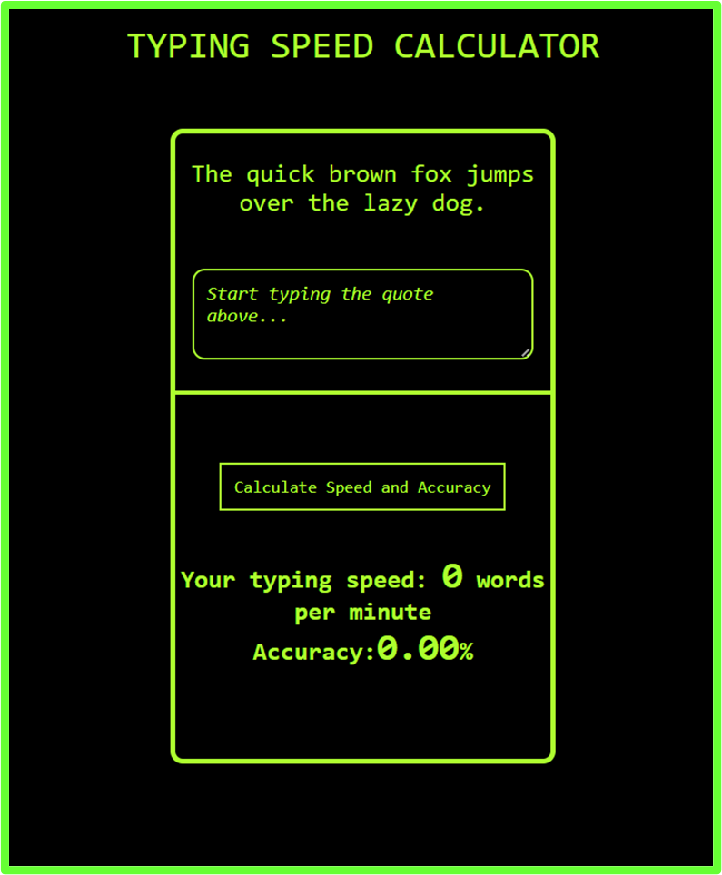
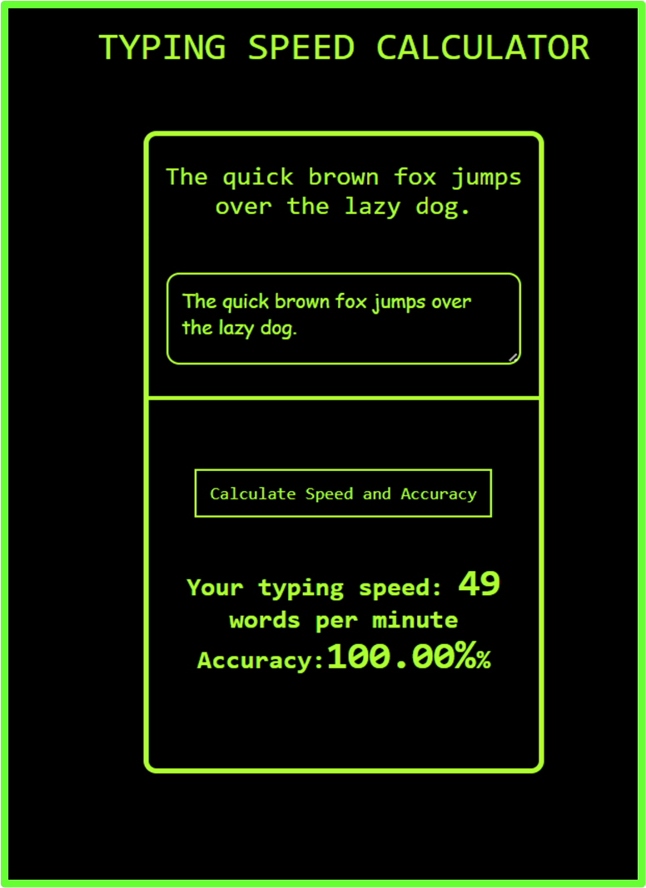
RESULT ANALYSIS

Slide 12


CONCLUSION
IN CONCLUSION, THE TYPING SPEED CALCULATOR PROJECT HAS BEEN SUCCESSFULLY IMPLEMENTED TO PROVIDE USERS WITH A VALUABLE TOOL FOR ASSESSING AND ENHANCING THEIR TYPING SKILLS. THE PROJECT FOCUSED ON CREATING A USER-FRIENDLY INTERFACE, ACCURATE SPEED CALCULATIONS, AND THE INCLUSION OF TYPING ACCURACY AS A SIGNIFICANT METRIC. SEVERAL KEY ASPECTS WERE ADDRESSED THROUGHOUT THE DEVELOPMENT PROCESS.

Slide 13


BIBLIOGRAPHY
· MonkeyType app
· https://www.geeksforgeeks.org/javascript/ (Geeks for Geeks JavaScript tutorial)
· https://www.geeksforgeeks.org/css/ (Geeks for Geeks CSS tutorial)
· https://www.youtube.com/@WebDevSimplified CSS Tutorials
· https://github.com/monkeytypegame/monkeytype (open source code for MonkeyType on GitHub).

Slide 14

THANK YOU!

